Slide 1


Slide 2
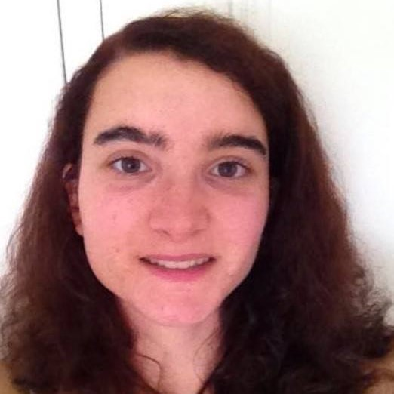
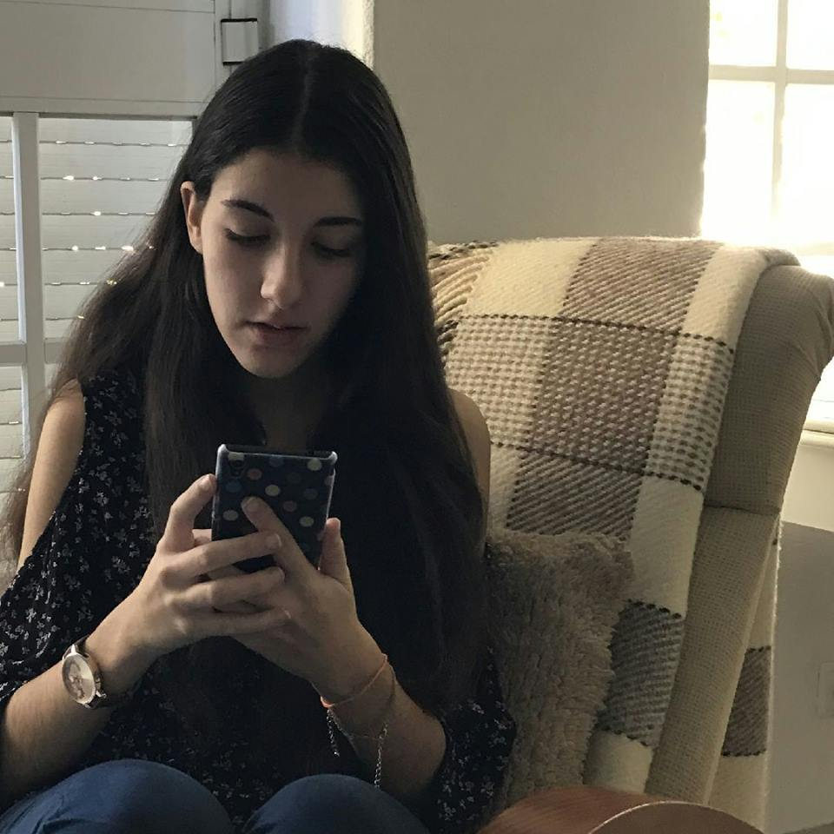
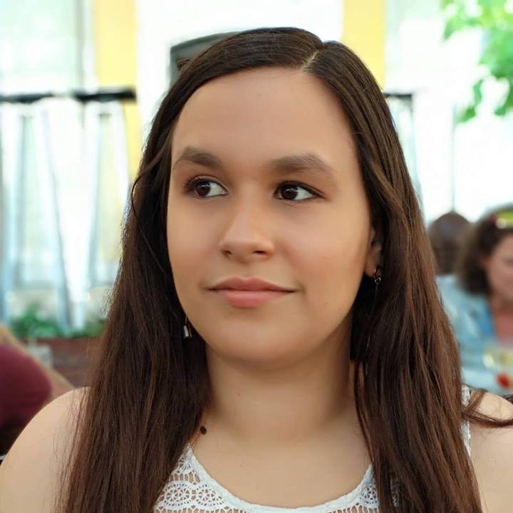
Bárbara Ramalho
GROUP MANAGER
Mafalda Morgado
RESEARCHER
Nádia Mourão
DESIGNER

Slide 3
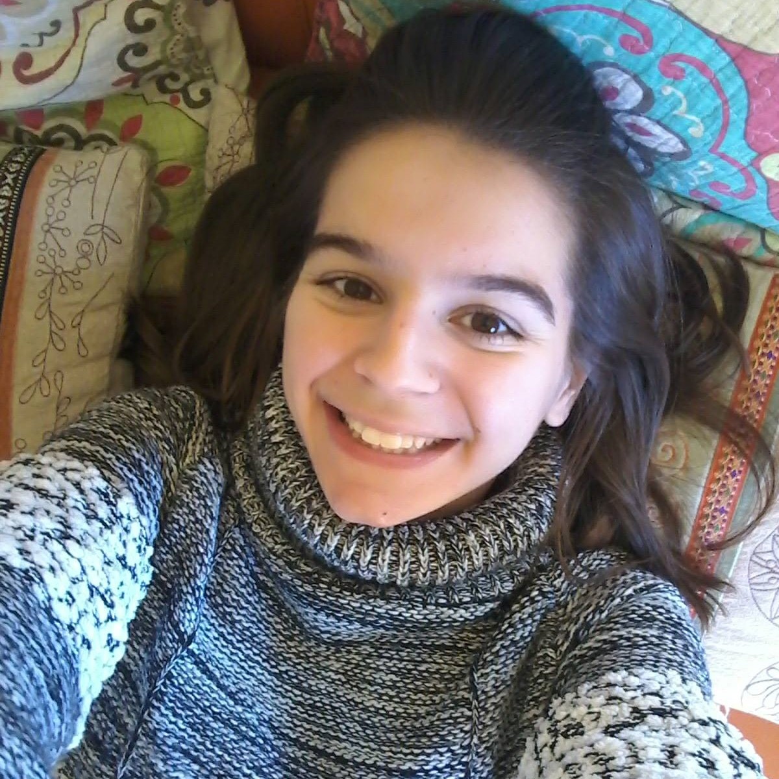
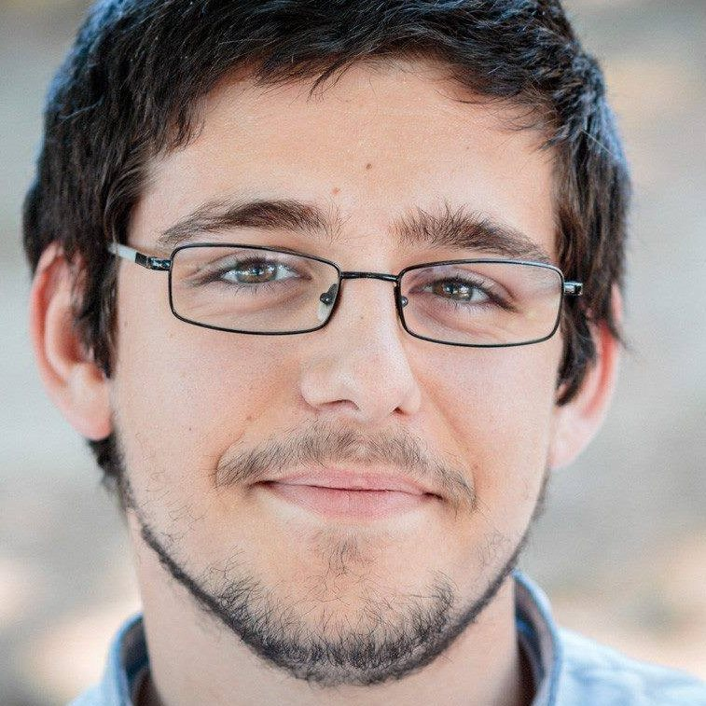
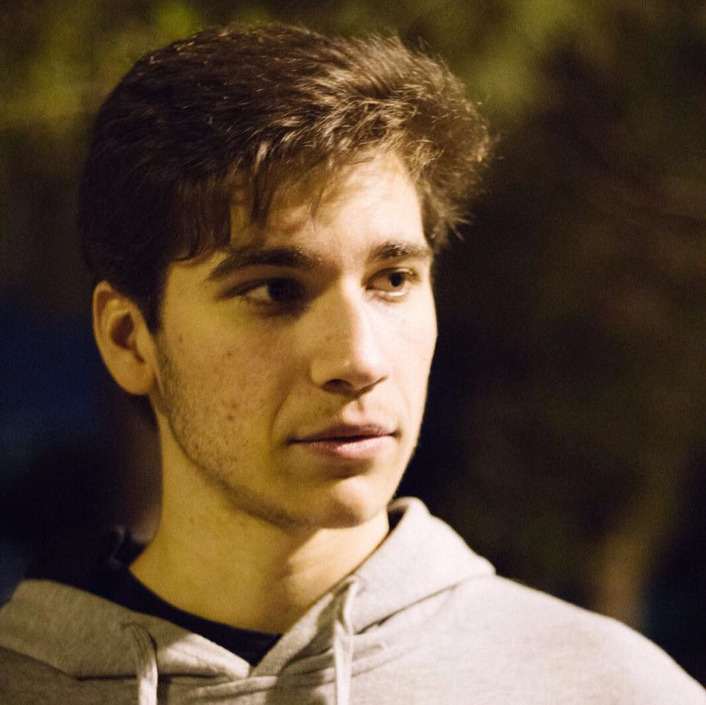
Carolina Veloso
FRONT-END DEVELOPER
Hugo Lencastre
BACK-END DEVELOPER
André Vieira
BACK-END DEVELOPER

Slide 4

Overview & Background

Slide 5
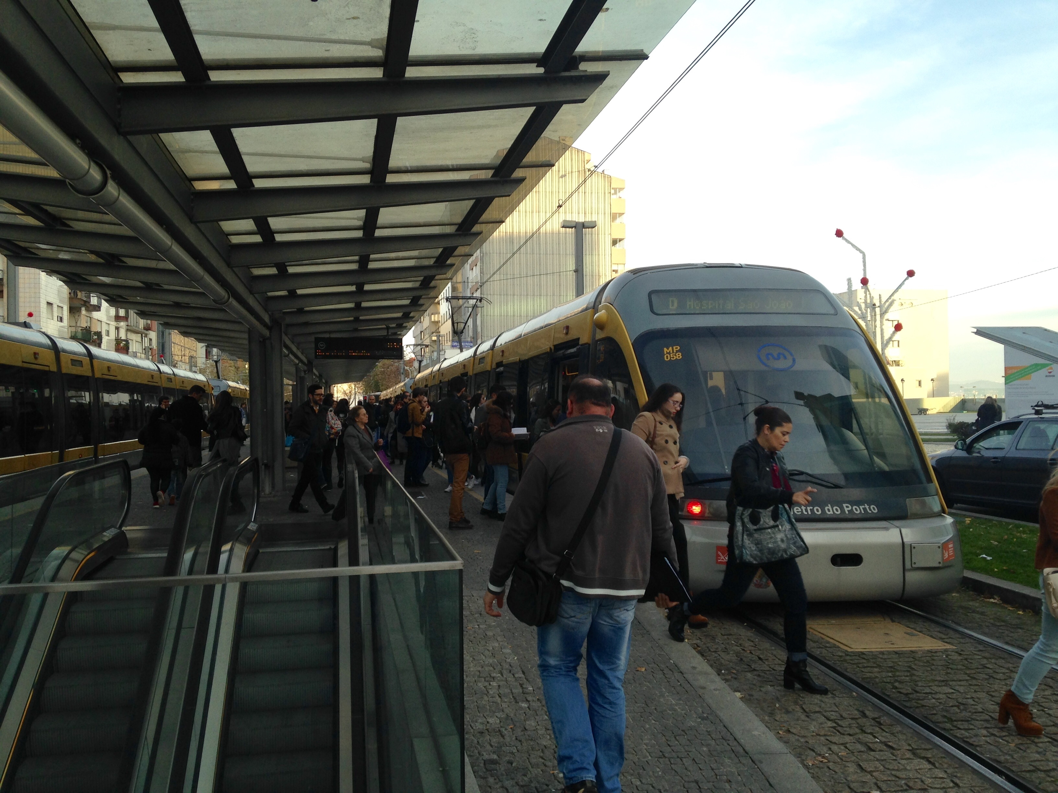
CONTROL FARE EVASION

Slide 6

SOLUTION CONCEPT

Slide 7
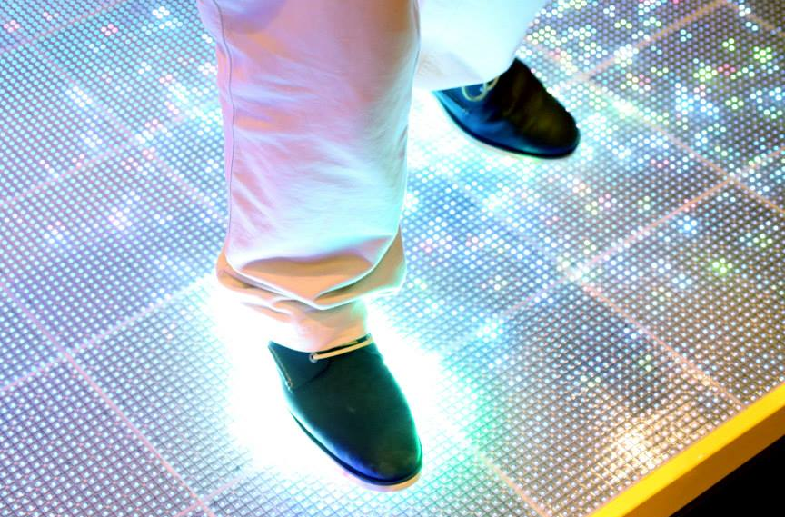
INTERACTIVE PLATFORM

Slide 8

COLOUR CODE
Green
Valid Ticket
Orange
Red
Invalid Ticket

Slide 9


PLATFORM – ARRIVAL

Slide 10
PLATFORM – GOING TO VALIDATE

Slide 11
PLATFORM - VALIDATING

Slide 12
PLATFORM - VALID

Slide 13
PLATFORM – WALK FREELY

Slide 14
INVALID TICKET

Slide 15
PLATFORM – FAILS TO VALIDATE

Slide 16
PLATFORM - INVALID

Slide 17

VIDEO

Slide 18

USER RESEARCH

Slide 19
USER RESEARCH
Enquiry
Field observations
Flash Interviews
One-on-one interviews
Focus groups
UNDERSTAND OUR USERS

Slide 20
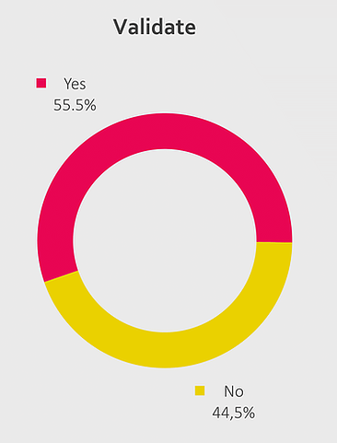
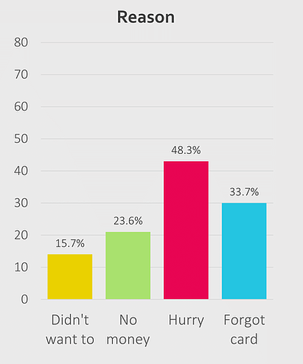
RESULTS

Slide 21
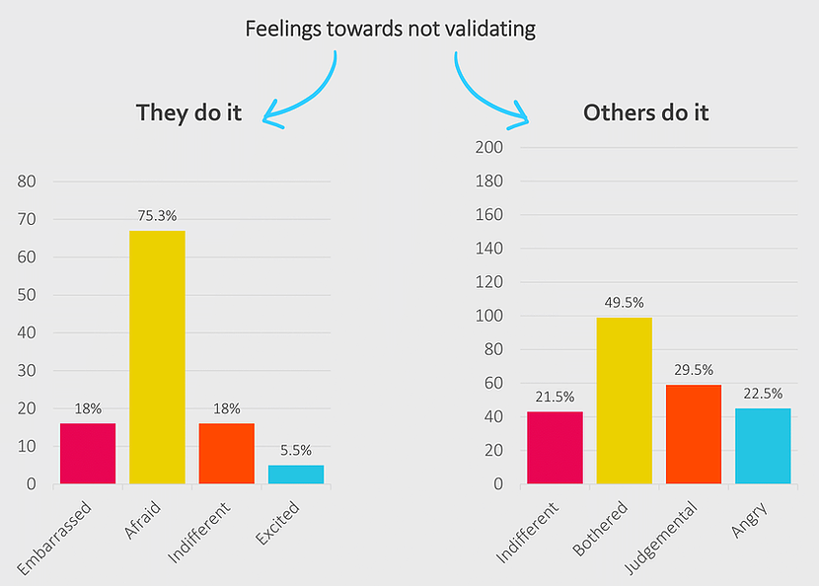
RESULTS

Slide 22


FARE-EVASION
When they do it
Fear
Anxiety
When they see it
Bothered
Judgmental
Indifferent

Slide 23

FEEDBACK
Main reason why people don’t validate
Because they forgot or were in a hurry

Slide 24

DESIGN PROCESS

Slide 25


DESIGN PROCESS
TESTING
REFINING

Slide 26
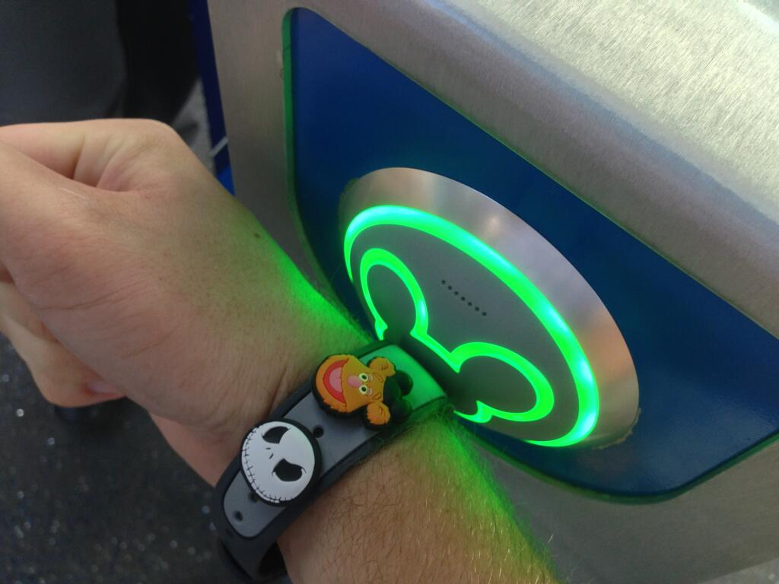
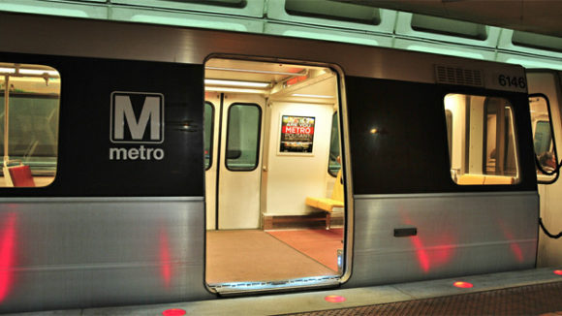
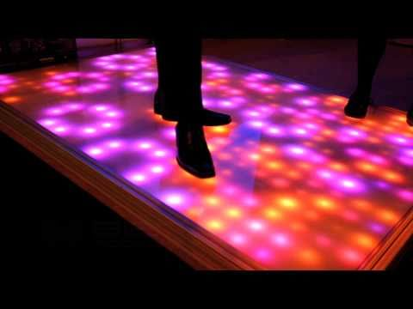
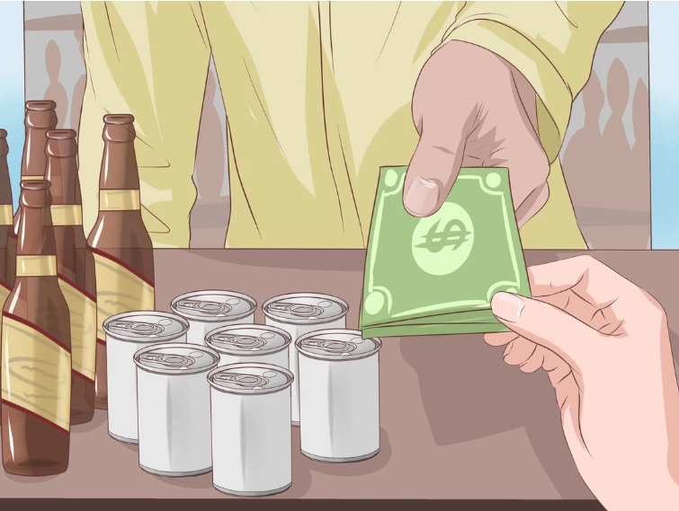
INITIAL BRAINSTORM

Slide 27
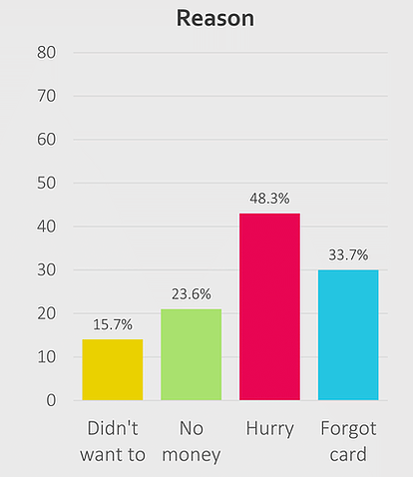
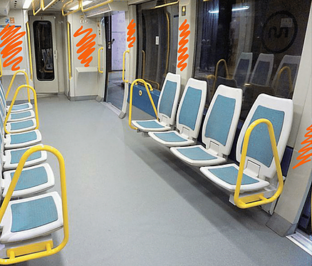



INITIAL FEEDBACK
Inside
validators

Slide 28
1st Iteration

Slide 29
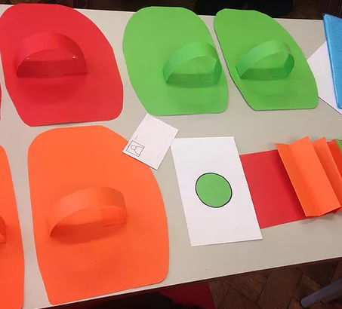
PAPER PROTOTYPE

Slide 30
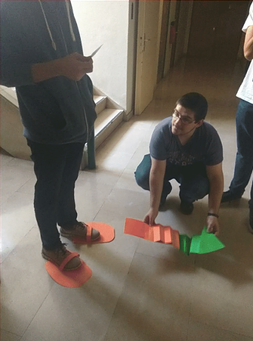
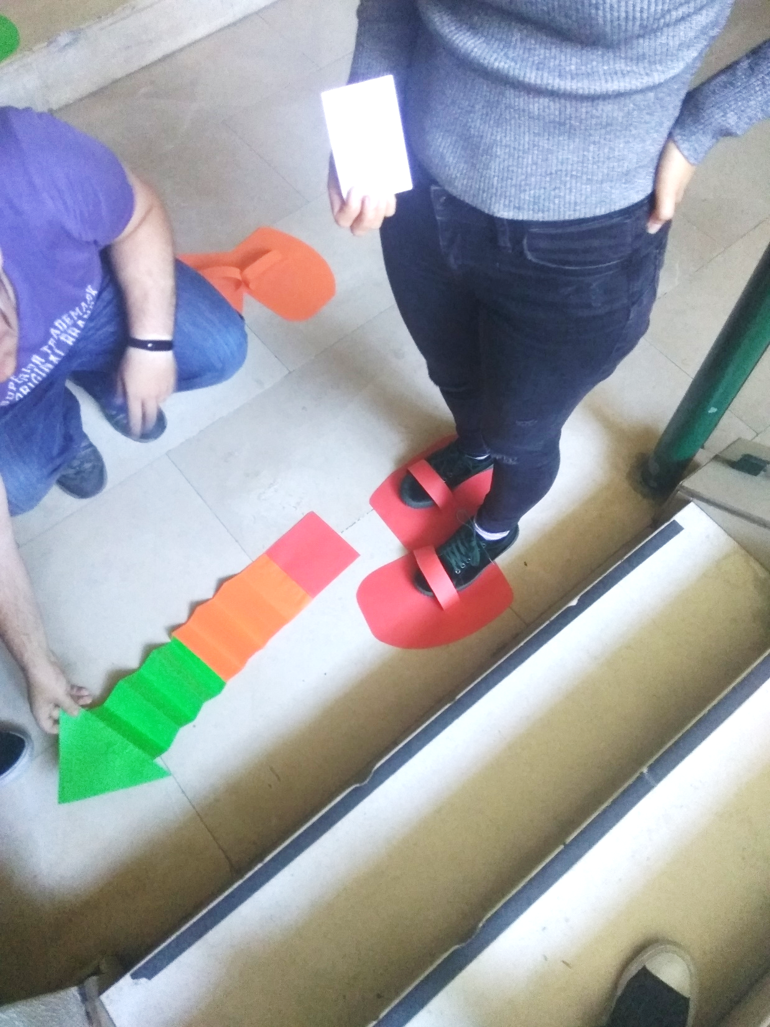
PAPER PROTOTYPE

Slide 31
WHAT DID WE LEARN?
POSITIVE FEEDBACK:
Colour code
Easy to understand
Intuitive
TO IMPROVE:
Sound feedback
Tries for validation

Slide 32
2nd Iteration

Slide 33
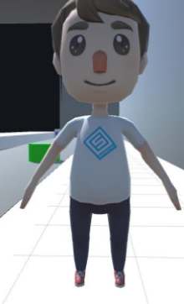
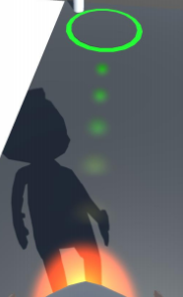
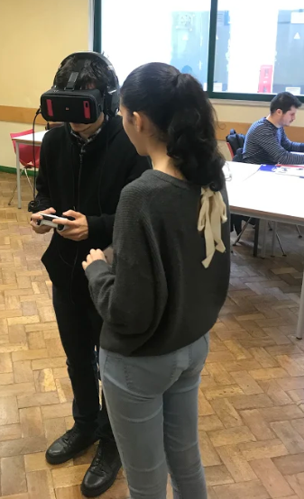
VIRTUAL REALITY - PROTOTYPE

Slide 34
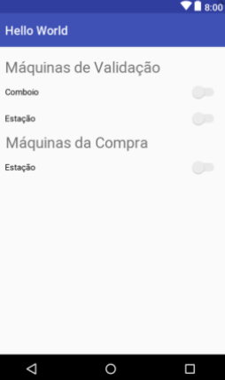
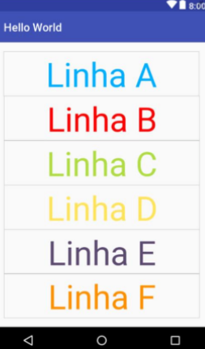
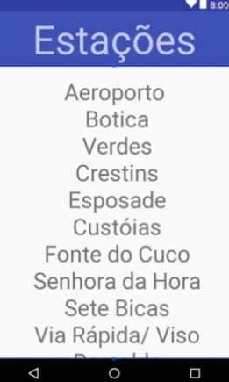
ANDROID APP - PROTOTYPE

Slide 35
WHAT DID WE LEARN?
POSITIVE FEEDBACK:
Simulation gives good understanding of our idea
App is functional
TO IMPROVE:
App design
Simulation dynamic arrows trail

Slide 36
3rd Iteration

Slide 37
MOST RECENT IMPROVEMENTS
Mostrar app nova

Slide 38

BUDGET SKETCH

Slide 39
BUDGET OVERVIEW
Material | Preço (€)
280 placas de ActiveFloor | 2 240 000
Maintenance
Employees
Licensing and inspections

Slide 40

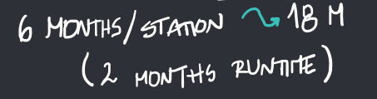
PILOT & APP
Material | Preço (€)
60 placas de ActiveFloor | 480 000
App | Preço (€)
Project Manager | 3000
Team (5 people) | 11 500
Total: | 14 500

Slide 41
PILOT & APP
Material | Preço (€)
ActiveFloor | 480 000
App | 14 500
Total: | 494 500

Slide 42
Thank you!
ANY QUESTIONS?
You can find us at:
https://walkinglight.wixsite.com/ccu-group7

